Slide 1
OTTER LAKE MUNICIPALITY
ADDRESSING INVASIVE SPECIES
PUBLIC MEETING
2024-05-04

Slide 2
OBJECTIVE
Solicit public input on how to control
invasive species in Otter Lake Municipality.
OUTLINE
Invasive species defined
Eurasian Milfoil - Environmental and Economic Impact
Photos/Locations in Lac de la Ferme & Petit Lac Cayamant
Biologist Recommendations
Actions taken to date by the Otter Lake Municipality
Proposed options for further actions
Public input

Slide 3
WHAT ARE INVASIVE SPECIES?
Plants, animals, organisms not native to the area
Most common types found in Outaouais area:
  Eurasian Water Milfoil and Zebra Mussels
Significant environmental impact on lakes
Serious negative impact on property values
Biologist confirmed Eurasian Water Milfoil in
Petit Lac Cayamant and Farm Lake

Slide 4
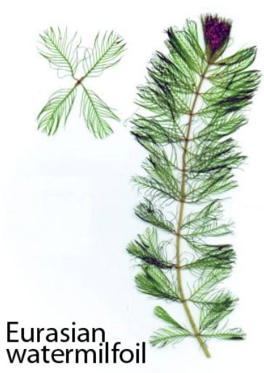

INVASIVE SPECIES - Eurasian Watermilfoil
Arrangement of leaves
Each stem of milfoil is surrounded by 3 to 6 leaves. Usually there are 4.

Slide 5
ENVIRONMENTAL IMPACT
Milfoil competes aggressively with native plants
Causes decline in oxygen levels which causes fish population to die off
Lakes can become un-swimmable
Difficult boating through dense mats
Eventual stagnant water – mosquitos (from lack of oxygen)
Also need to guard against zebra mussels – extremely difficult to swim – leave deep gashes

Slide 6
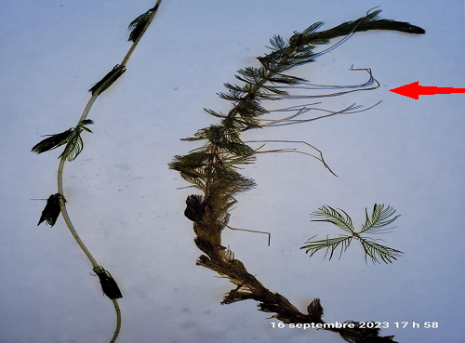
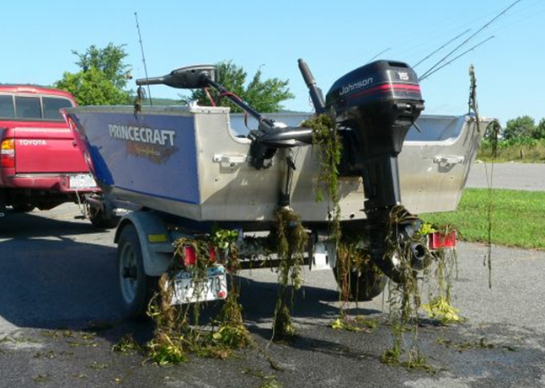
Eurasian Milfoil

Slide 7
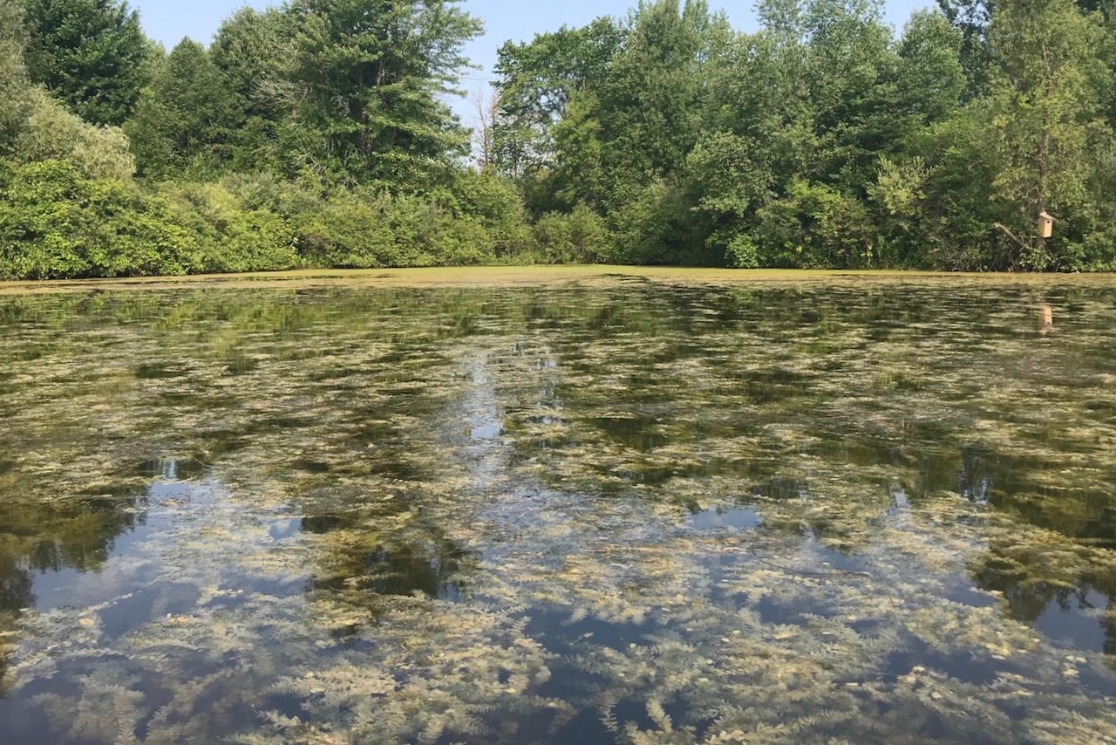
INVASIVE SPECIES
Example: Uncontrolled Eurasian Milfoil

Slide 8
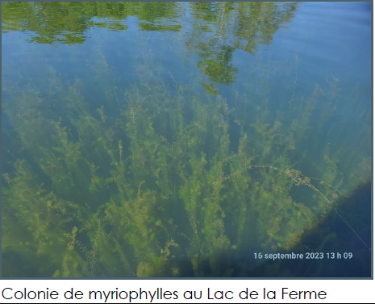
INVASIVE SPECIES
Lac de la Ferme – Eurasian Milfoil

Slide 9
ECONOMIC IMPACT
Waterfront property values decline
Higher property taxes / millrates for everyone
Tourism declines, hurting local businesses
Ongoing high costs to control

Slide 10
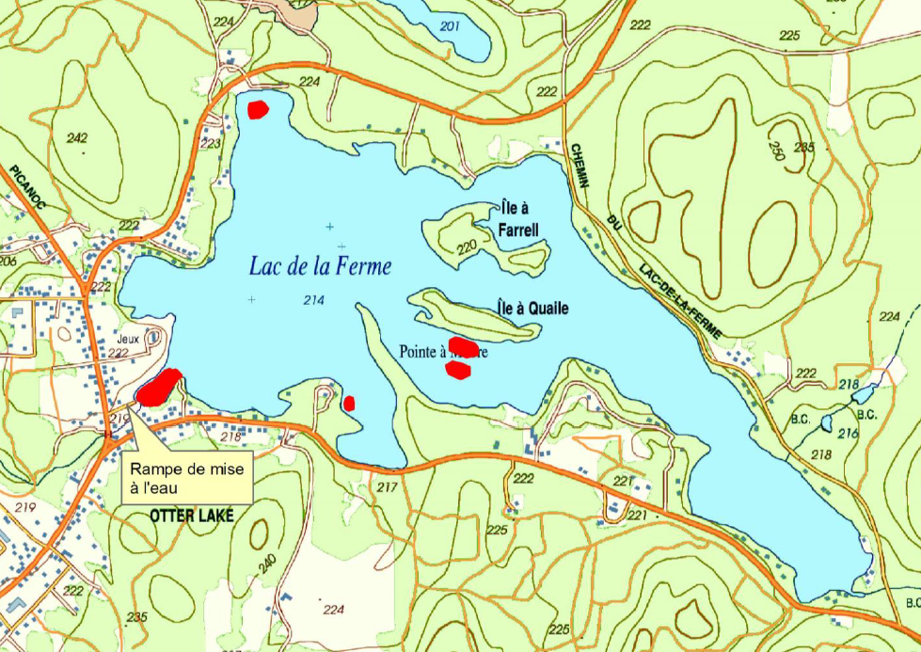
INVASIVE SPECIES – Lac de la Ferme

Slide 11
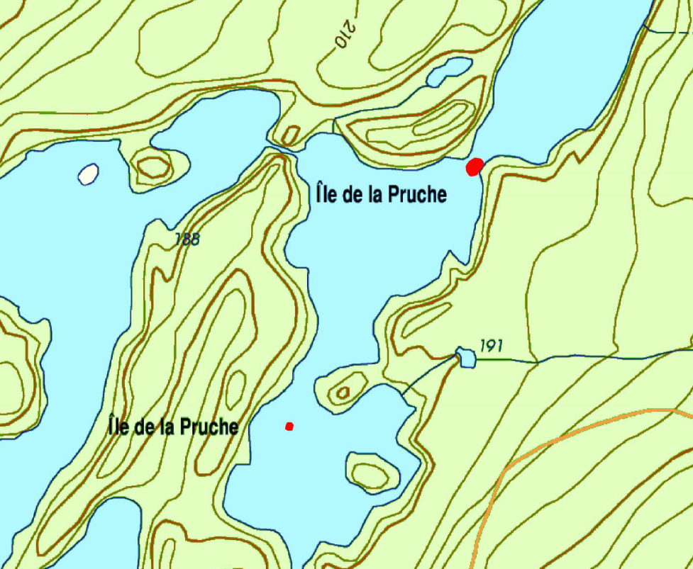
INVASIVE SPECIES – Petit Lac Cayamant

Slide 12
PREVENTING SPREAD WITHIN LAKES AND TO OTHER LAKES
Biologist’s recommendations:
Public Education
Boat Washing
Boat Traffic Control
    Focus on boat launch area
    Buoys, Other
Shoreline Management

Slide 13
ACTIONS TAKEN TO DATE
Boat washing program
  By-law, Wash Station, Signage, Education Brochure, Grants, Enforcement, Buoys for Petit Lac Cayamant
Attended conference on invasive species
Biologist- surveyed Petit Lac Cayamant & Lac de la Ferme
Invasive species committee formed
ABVdes7 meeting
Minister of Environment letter
Public announcements in Equity, Taxation Newsletter
Public meeting (today)
  Provides more information to taxpayers
  Solicit support for future actions

Slide 14
PROPOSED ACTIONS
Continue boat washing enforcement, including fines
Continue shore line management enforcement
Install marker buoys in both lakes
Inspect 6 more lakes – volunteers with boats
Limit the use of Lac de la Ferme boat launch
  to taxpayers only
6. Pursue methods to remove milfoil
  Tarps (laid by divers)
  Removal by hand (divers)
  Potential herbicide recently approved
  Grants

Slide 15
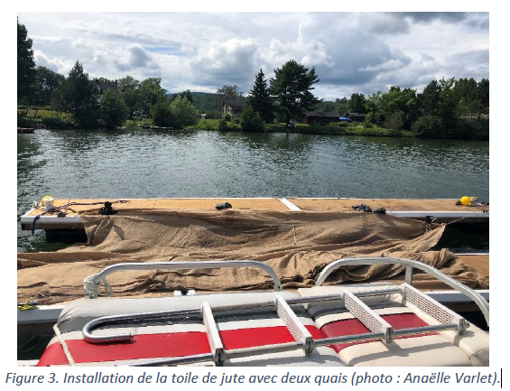
Blue Sea Lake Tarp Installation

Slide 16
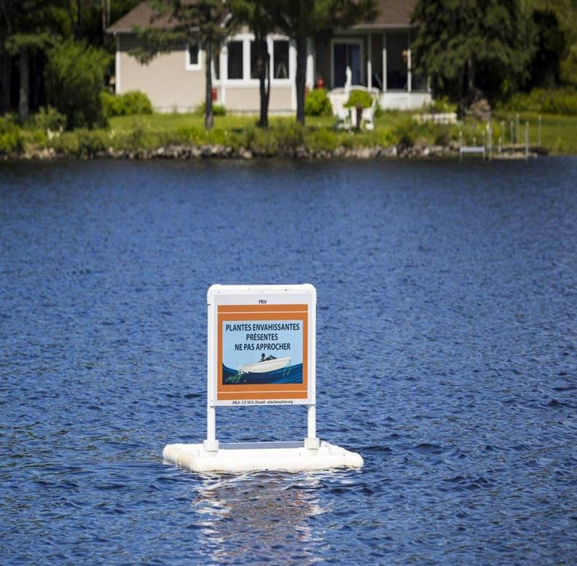
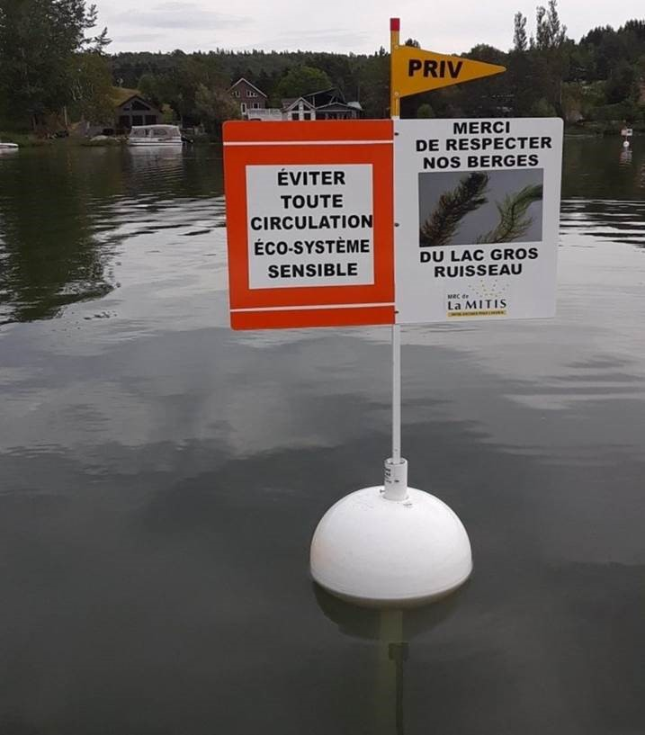
Marker Buoys

Slide 17
HOW CAN WE ALL HELP STOP THE SPREAD?
Wash boats thoroughly before launching and when leaving the lake
Avoid driving boats through the milfoil
Watch for milfoil in your lakes & report to office
Skim floating pieces and remove from the lake
Minimize severe wave action (10km/h within 30m of shore)
Avoid boating near shorelines
Follow good shore management practices
Be vigilant & report anyone not following Municipal By-laws and environmental rules

Slide 18
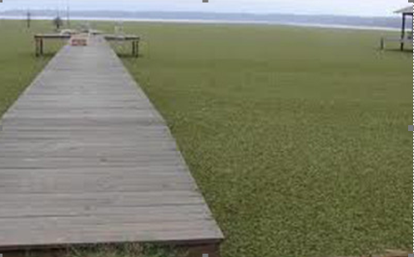
INVASIVE SPECIES
Dock surrounded by Eurasian Milfoil

Slide 19
DISCUSSION
Questions
Comments
Suggestions

